Slide 2


Slide 3
Diseases
Environment
Toxiques
Microbes
Genes
✔
✔
✔

Slide 4
Genes & Diseases
ENVIRONMENT
GENES
Pancreatitis
Thrombosee
Alzheimer
Crohn
Cancer
Hypertension
Diabetes
Huntington
Cysitic
Fibrosis
Muscular
Dystrophy
Poisonings
Accidents
Infections
Hereditary cancers
Hereditary Hemochromatosis
acquired complex monogenic (multifactorial)
MUTATIONS
POLYMORPHISMS
2020………….2010…..……..2000…..…....1990.…….…1980
modified from Stylianos Antonarakis

Slide 5
Genetic susceptibility to diseases
Single gene
Multiples genes
  Genetic predisposition
environment
Hemophilia
Diet
Lifestyle
Smoke
"Environment"
PCU
  Multifactorial diseases
Modified from Stylianos Antonarakis

Slide 6
According to curated computer databases, 1’293 genes are associated with PD (MalaCards: Human Disease Database). However, in 2024, only around 60 genes were identified as predisposing to PD.
The frequency of genetic forms of PD is estimated at only around 15%, according to two large studies involving multi-centric samples (Westenberger, Bruggemann et al. 2024).

Slide 7
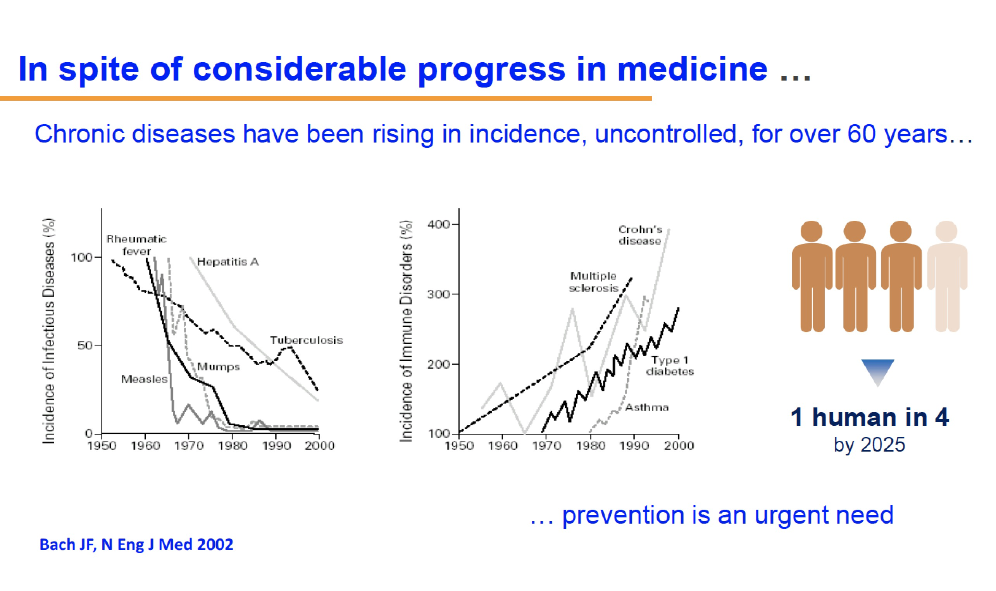

Slide 8


Slide 9
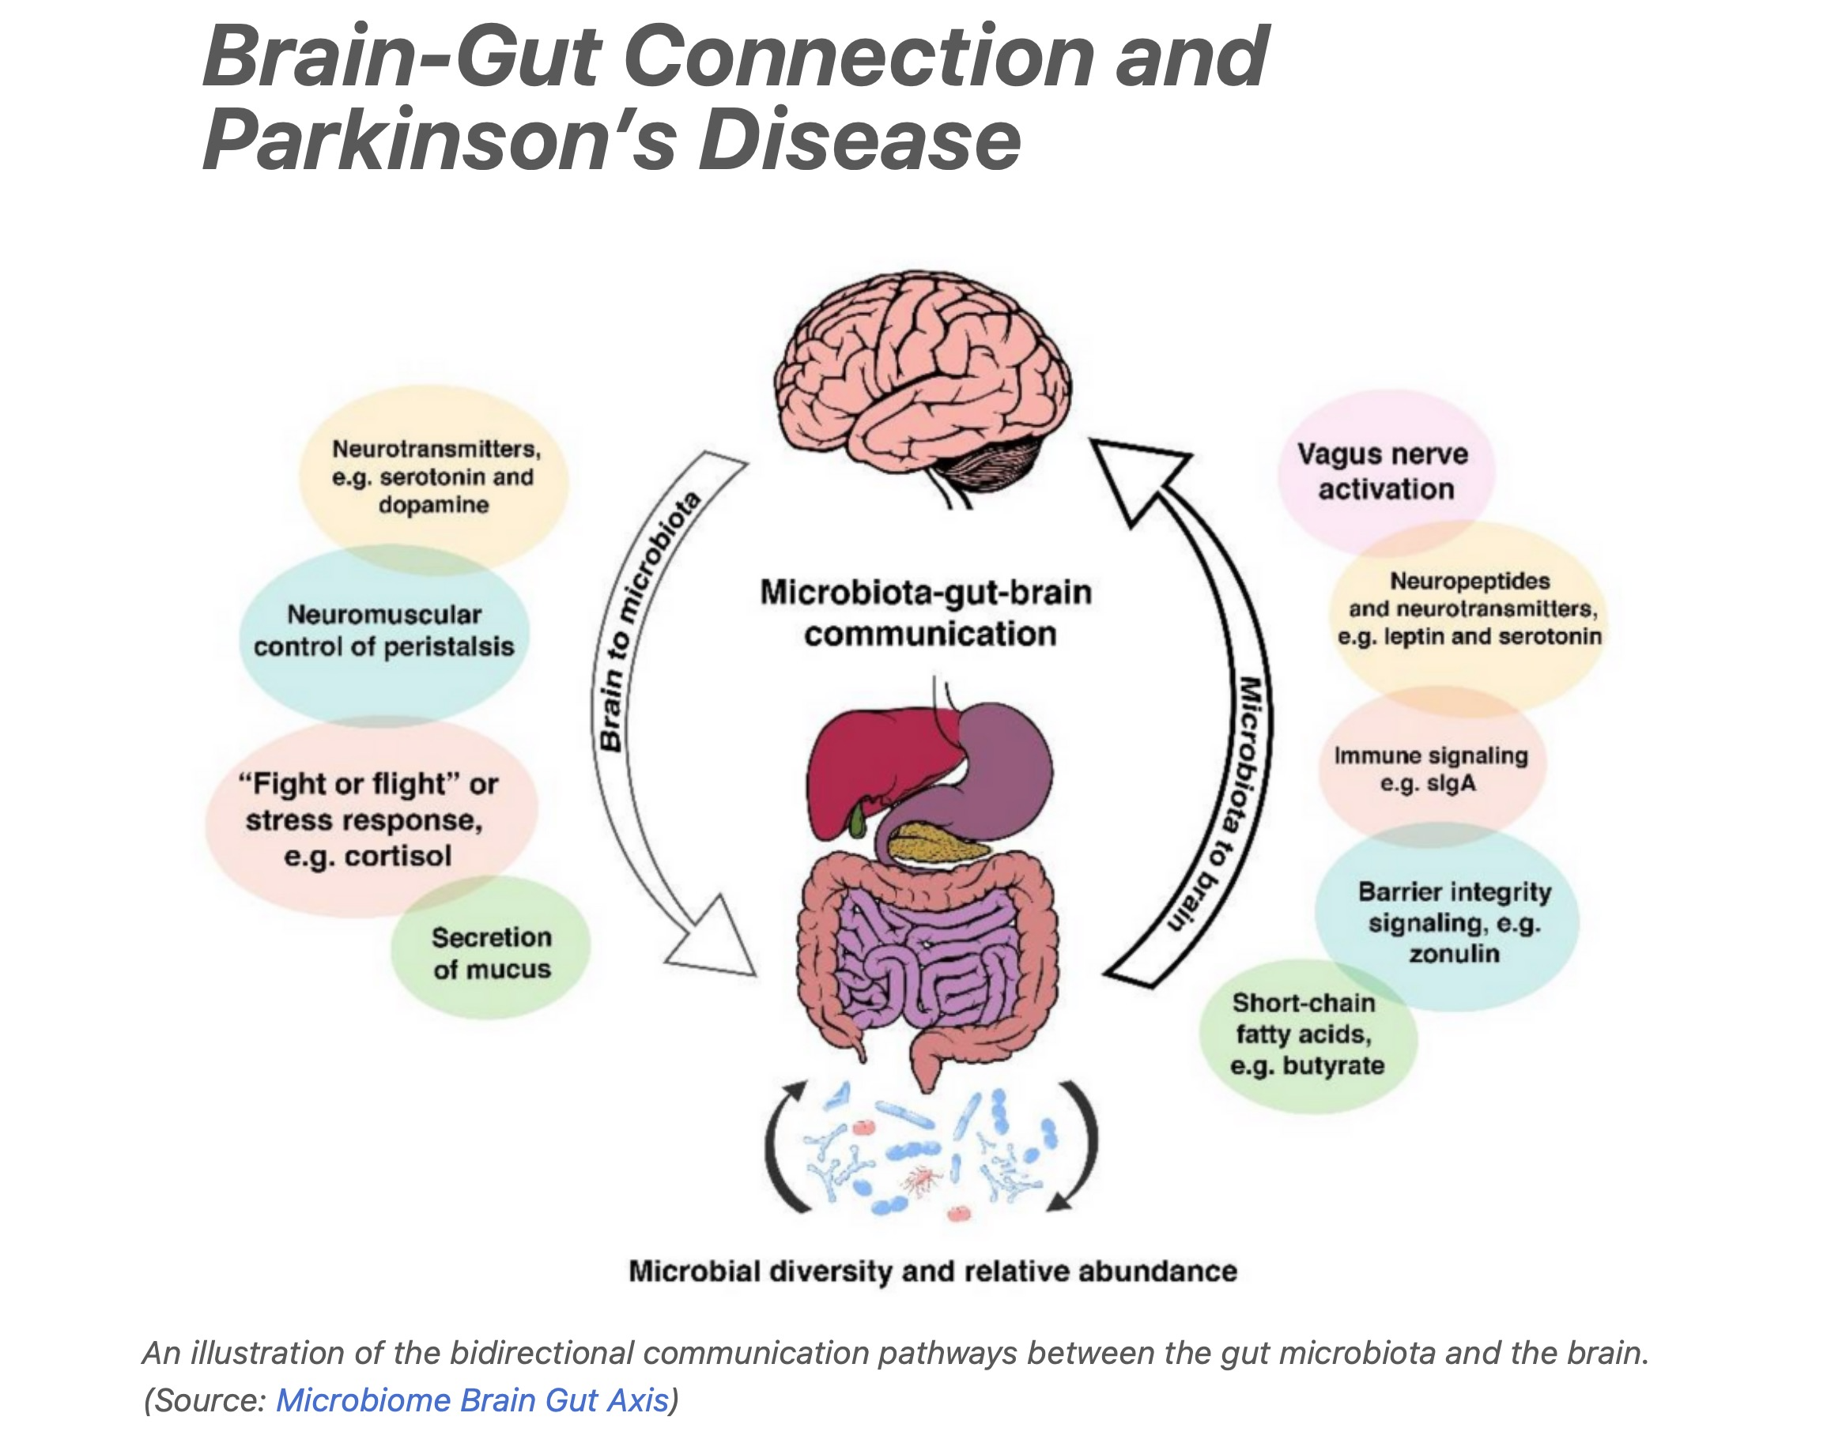

Slide 10
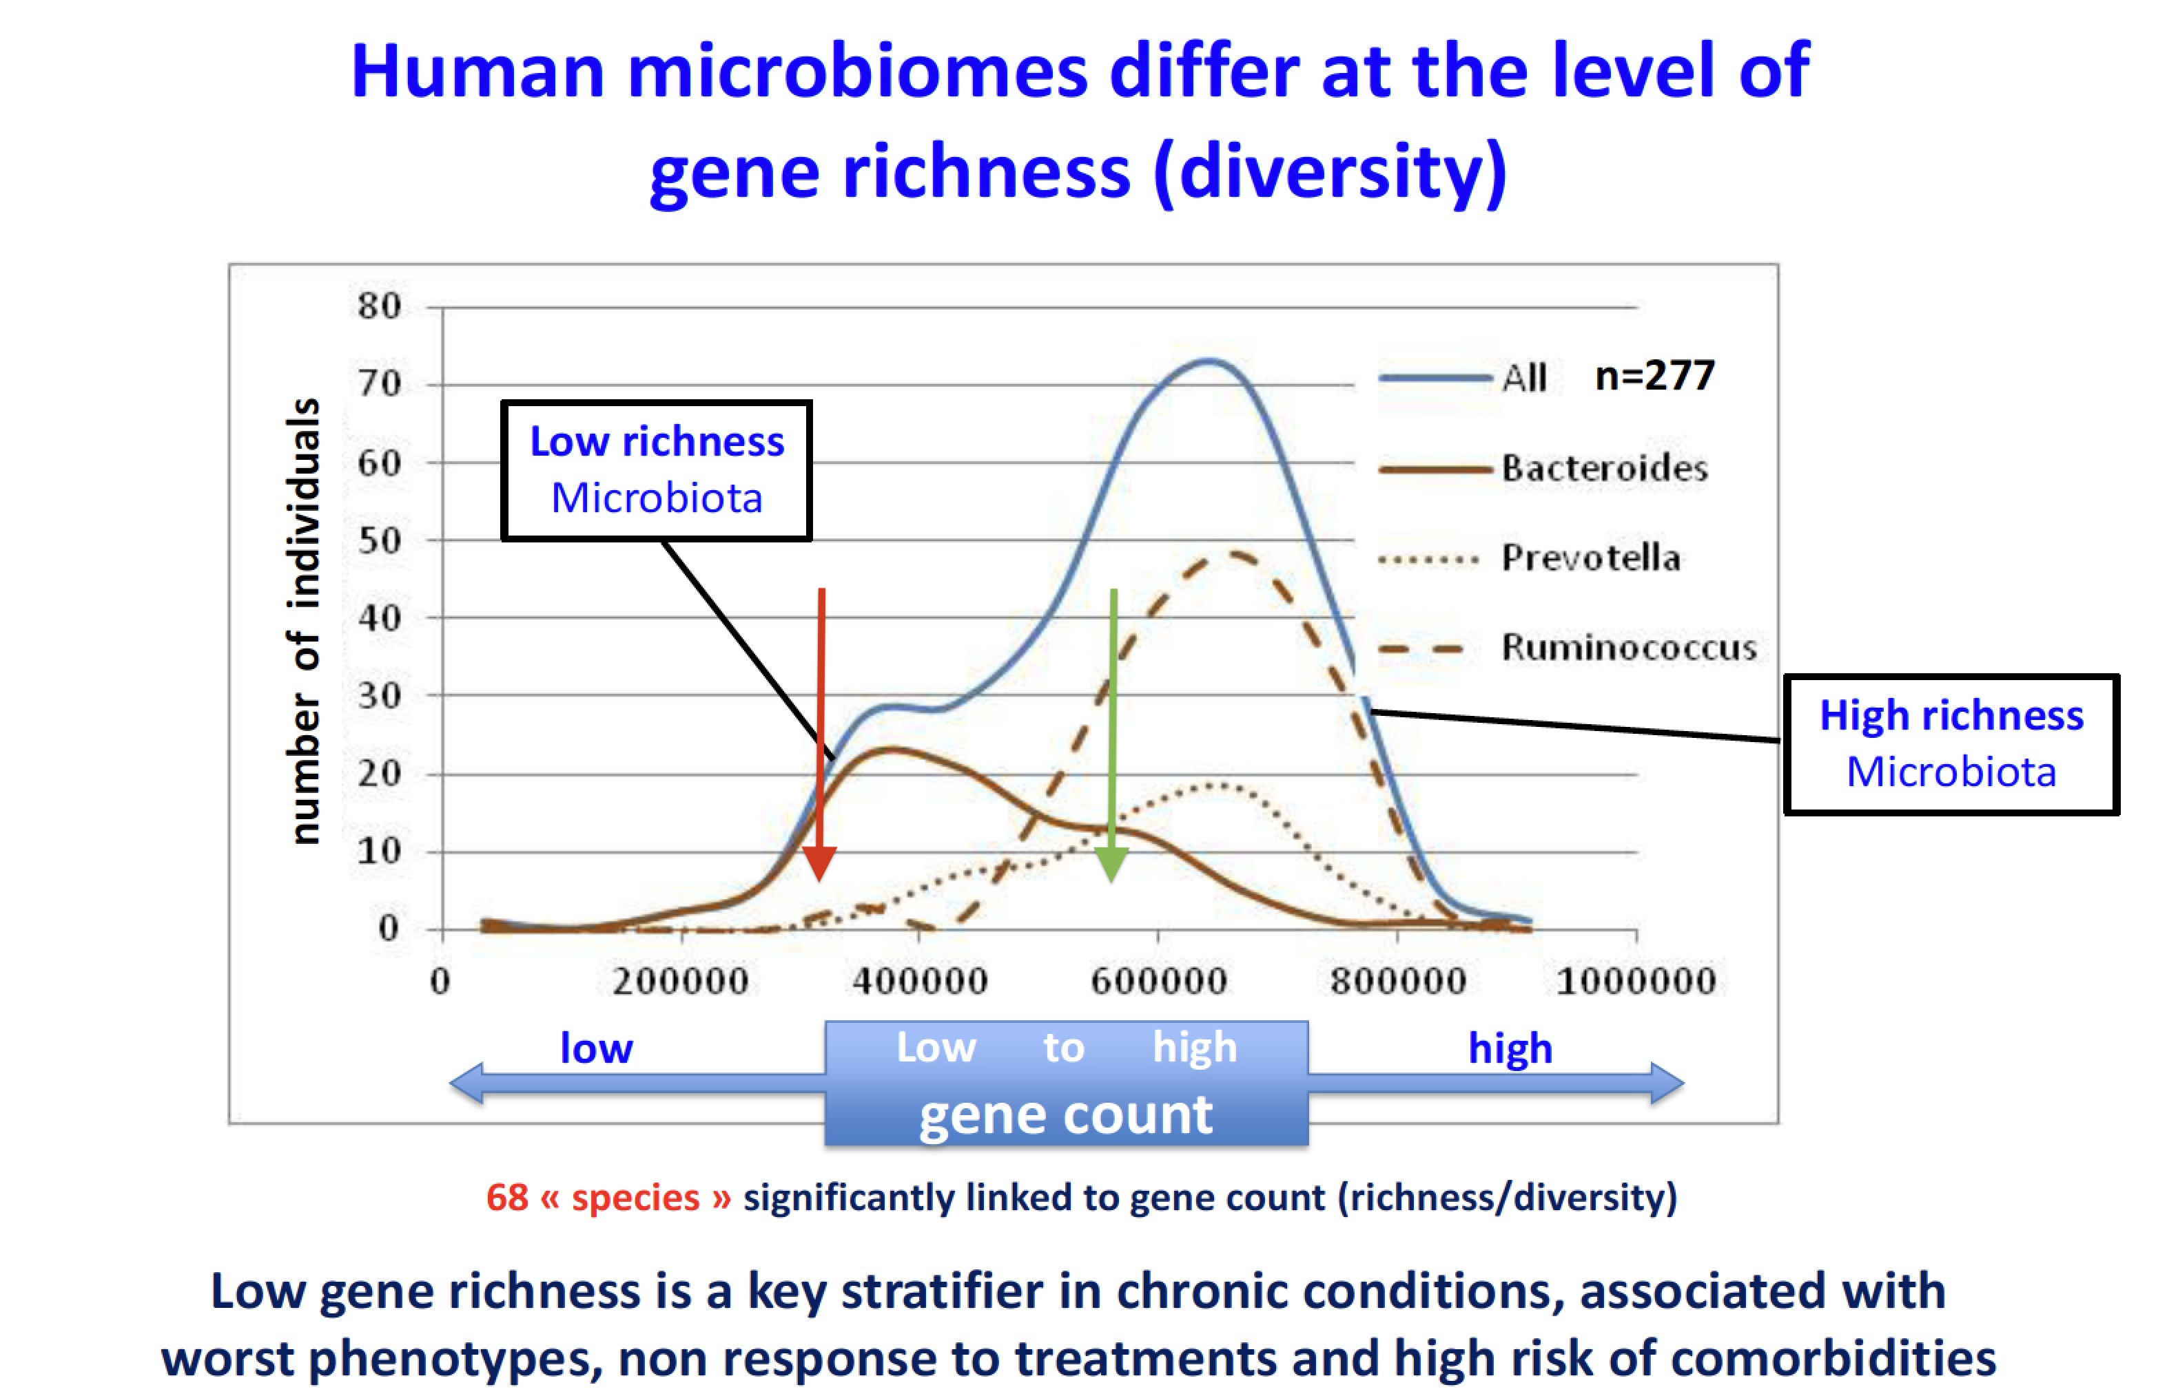

Slide 12

Thank you for your attention!

